Slide 1
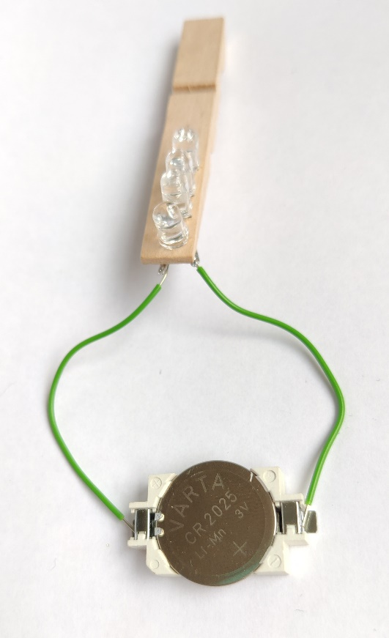
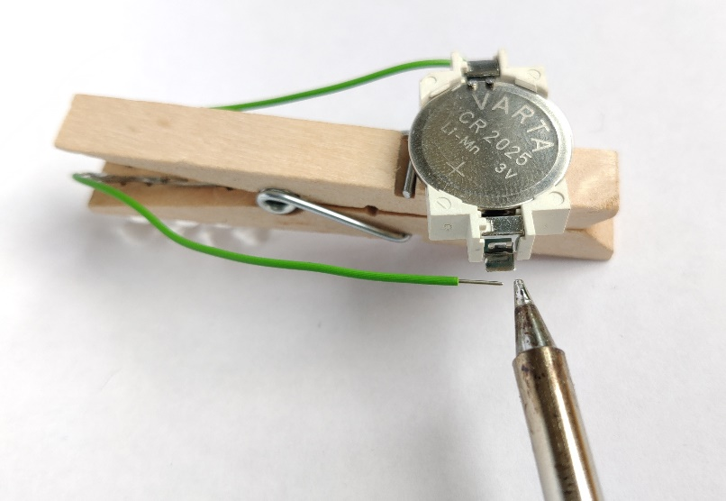
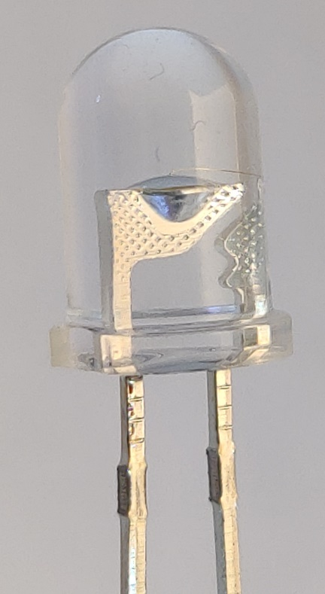
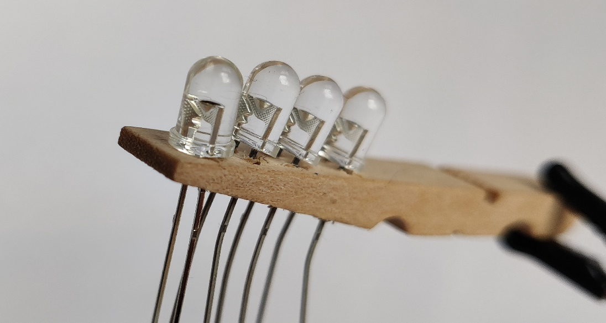
Place battery into battery holder
Hold one wire to each leg of the holder
Check if all LEDs light up
If not, swap cables (left side with right side and vice versa) and test again
If they still do not light up, check below
Solder cable to battery holder so that LEDs light up
Reassemble peg
Use hot glue to attach battery holder to the back side
Optional: paint and decorate peg
Finished
If none of the LEDs light up, one might be rotated: You can spot a small triangle in every LED. All of these triangles must be in the same direction. If you spot a reversed one, use the soldering iron to remove and turn it around

Slide 2
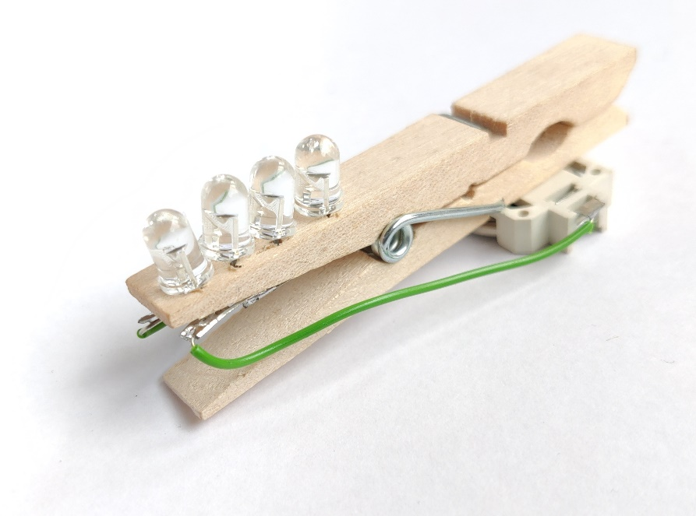
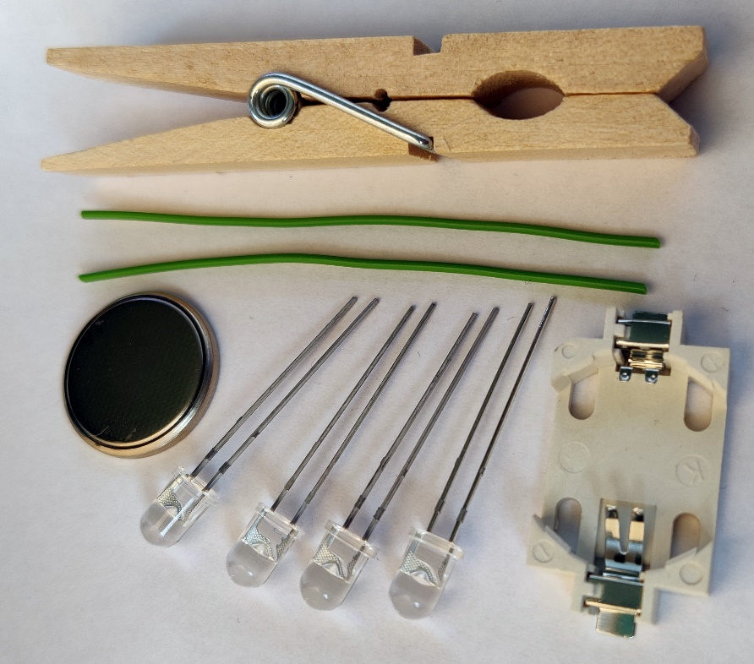
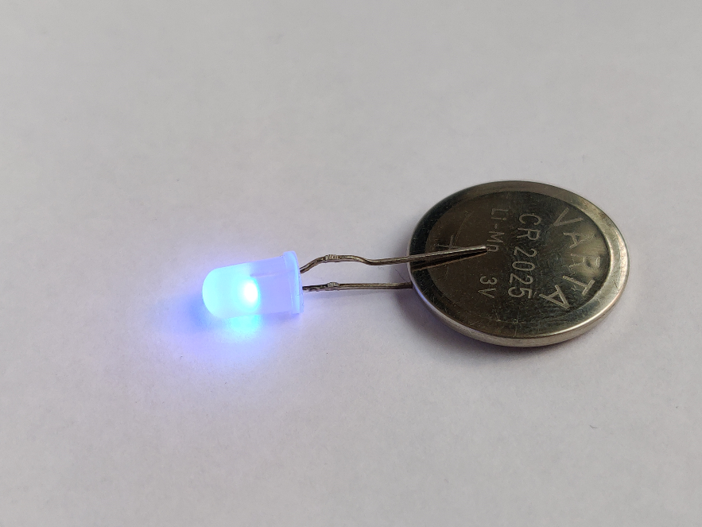
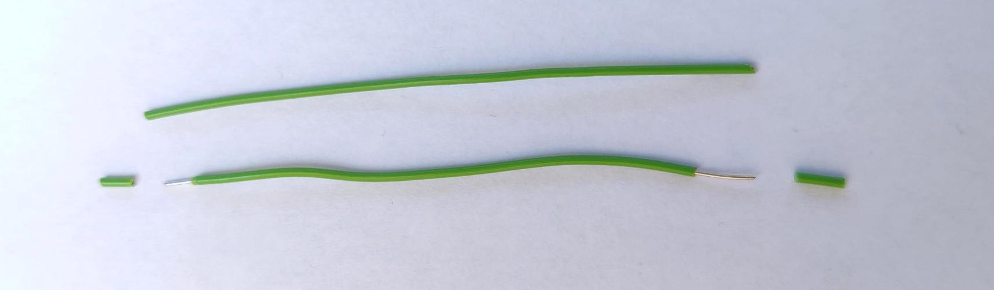
Nibbleklammer
A tutorial
“nibble” = a small byte
½ “byte” = 1 nibble = 4 bit
1 peg
2 wires, as long as the peg
1 battery
1 battery holder
4 LEDs (Nibble variant) or 3 LEDs (fast variant)
Test one LED and battery
Long leg of LED needs to touch plus of battery
Strip both ends of both wires (cut gently and pull to remove plastic or use a wire stripper)

Slide 3
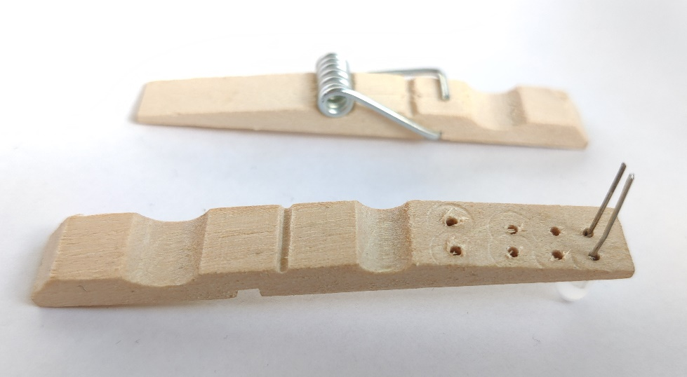
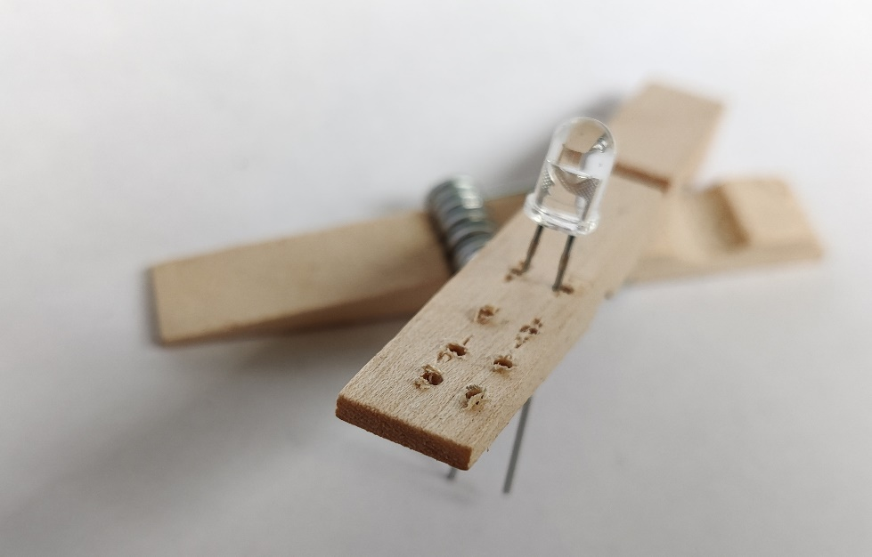
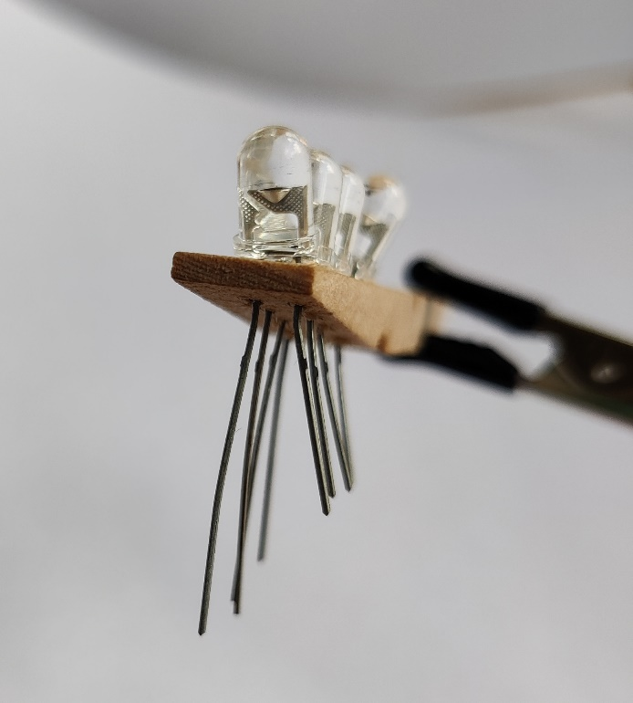
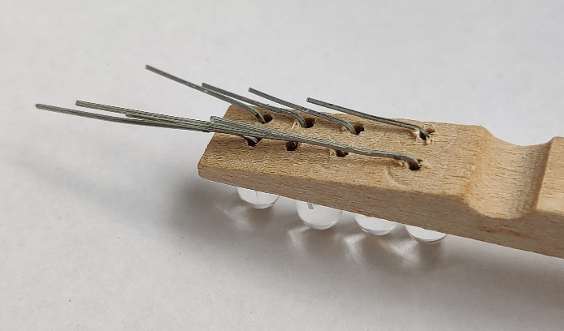
Disassemble peg
Drill two holes for each LED
Leave enough space in between the holes for the LEDs to fit (as shown in the picture)
Insert legs through holes to (from straight side of the peg to angled side)
Important: All long legs to one side
Check again:
All short legs on one side
All long legs on the other side
Bend all legs of the LEDs to one direction (preparing for soldering)
All long legs should touch each other
All short legs should touch each other

Slide 4
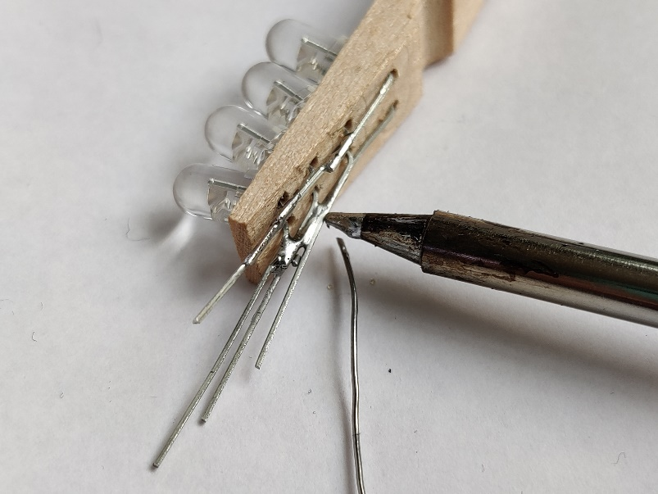
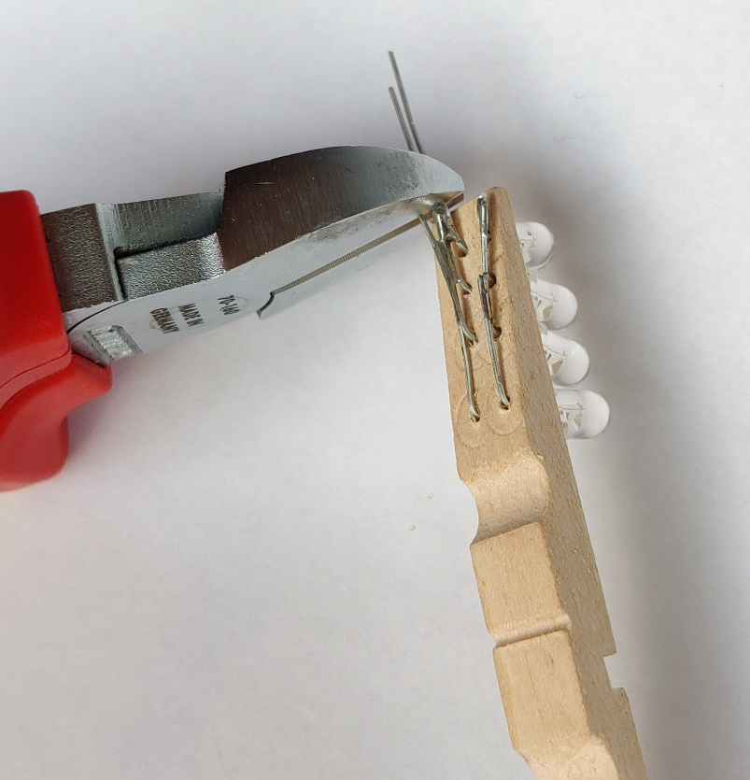
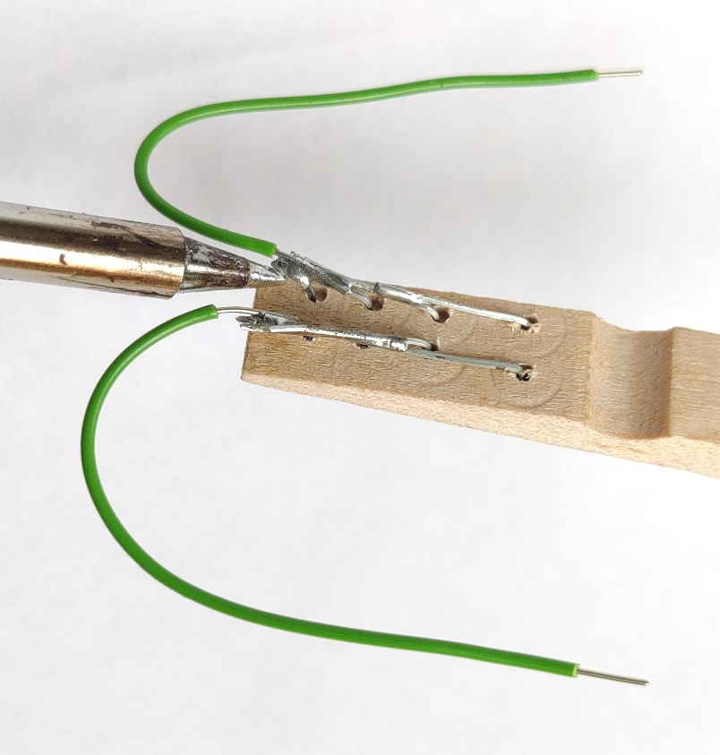
Soldering
1 soldering iron 320-350°C
Some solder (looks like some very soft wire)
Solder long legs together (connect them using solder and soldering iron)
Solder short legs together
Remove excess legs with wire cutter
Solder one wire to each row of legs
1 wire is for “plus” of the battery
1 wire is for “minus” of the battery

